Slide 1
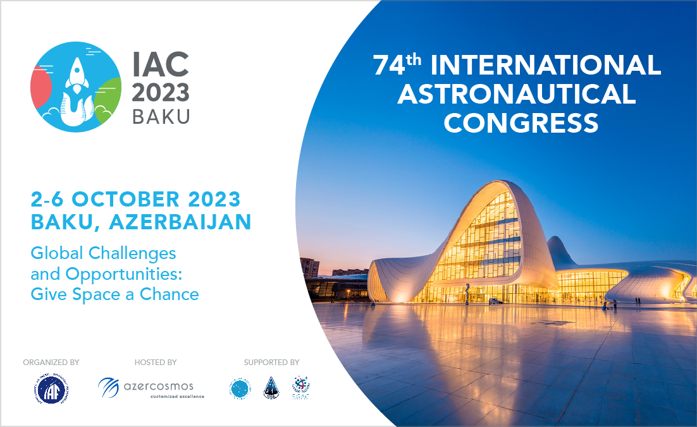
Insights for SETI from linguistics studies in the Peruvian Amazon
Paolo Musso, Wilmer Atachahua Ursua, Jhomira Larissa Aylas Torres,
Guisella Azcona Avalos, Luzmila Casique Coronado, Liz Chávez Sánchez,
Gedeon Comante Asencio, Rudy Walter Flores Durand, Juan López Bautista, Janina Navarro Linares, Lourdese Yessenia Paredes García,
Jovita Vásquez Balarezo, Remigio Zapata Cesareo, Esaú Zumaeta Rojas

Slide 2
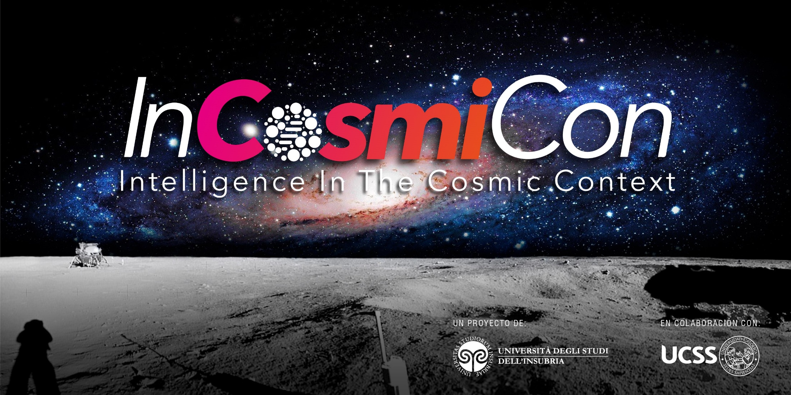
This talk incorporates results from some research
projects supported by the InCosmiCon Research
Center at the University of Insubria (Italy)

Slide 3
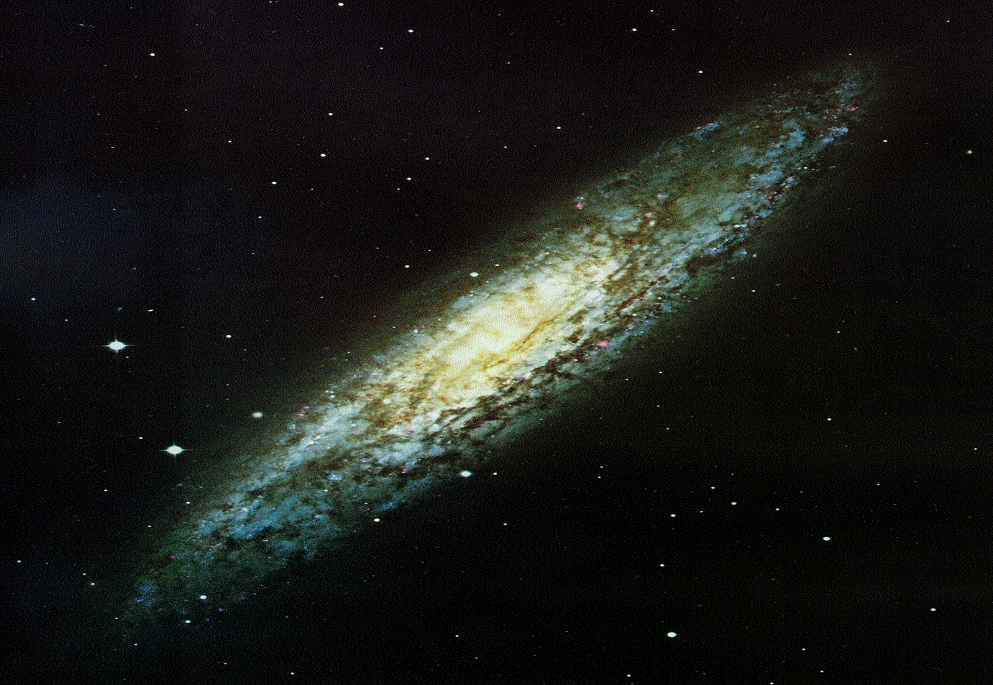
AS WE ANNOUNCED
AT THE …

Slide 4

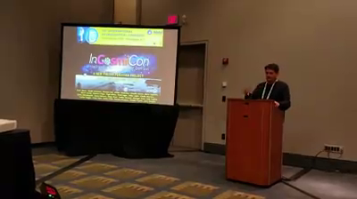
ON 26/06/2020 WE CREATED …

Slide 5
A RESEARCH CENTER BASED AT THE …

Slide 6

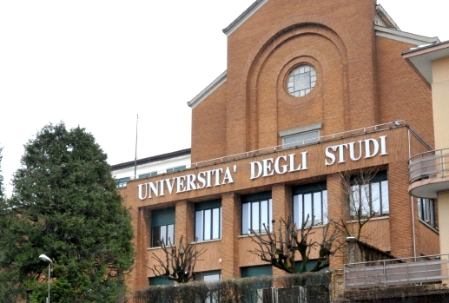
IN COLLABORATION WITH …

Slide 7

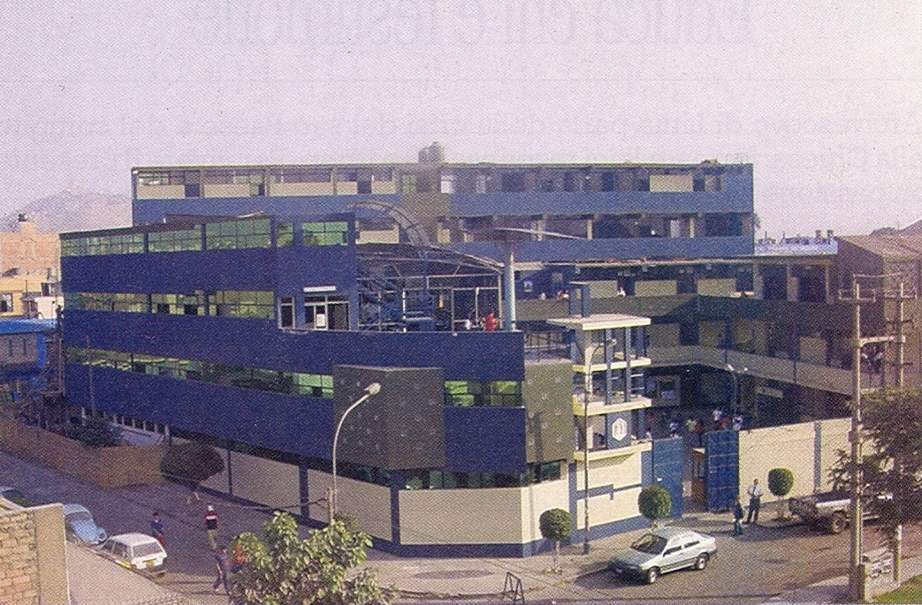
AND ESPECIALLY WITH ITS …

Slide 8
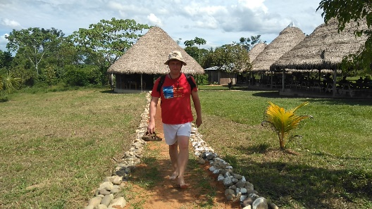
AMAZONIAN BRANCH UCSS-NOPOKI
OUR MEMBERS ARE ALREADY …
AND MANY OTHER SUBJECTS …

Slide 9
56
COMING FROM 10 COUNTRIES…

Slide 10
ITALY
PERU
ARGENTINA
MEXICO
CANADA
UNITED STATES
UNITED KINGDOM
HOLLAND
CHINA
BANGLADESH

Slide 11
WE ARE NOT STUDYING ‘’ONLY’’ SETI, BUT ALSO SETI

Slide 12
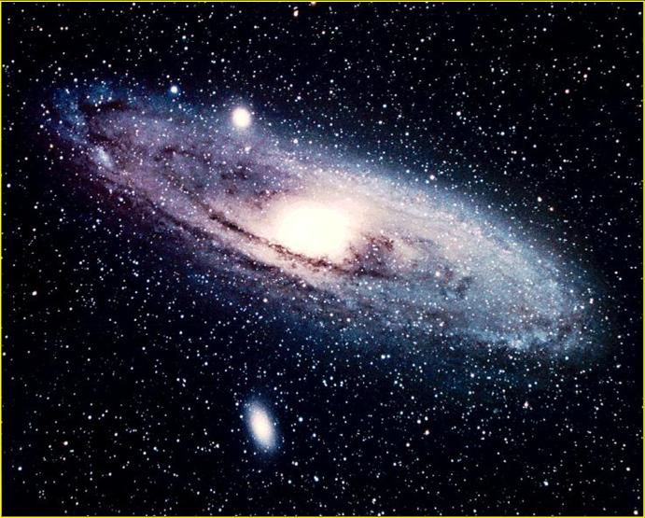
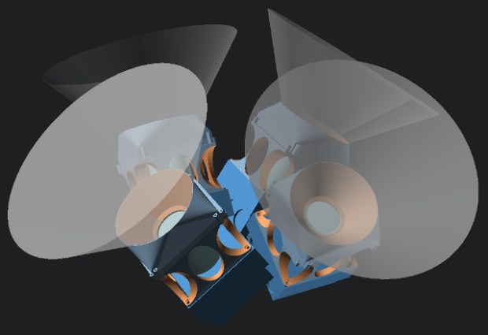
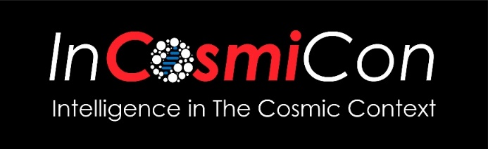
CREATING AN OPTICAL SETI PROGRAM AT THE UNIVERSITY OF SAN MARCOS

Slide 13
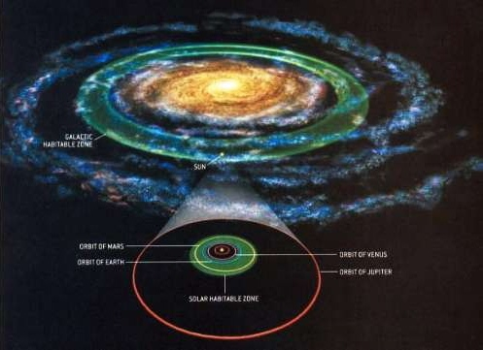
TESTING THE POSSIBILITY OF “GALACTIC HABITABLE ISLANDS”
Galactic Habitable
Islands ?
Stellar Habitable Islands (Europa, Enceladus, Titan)

Slide 14
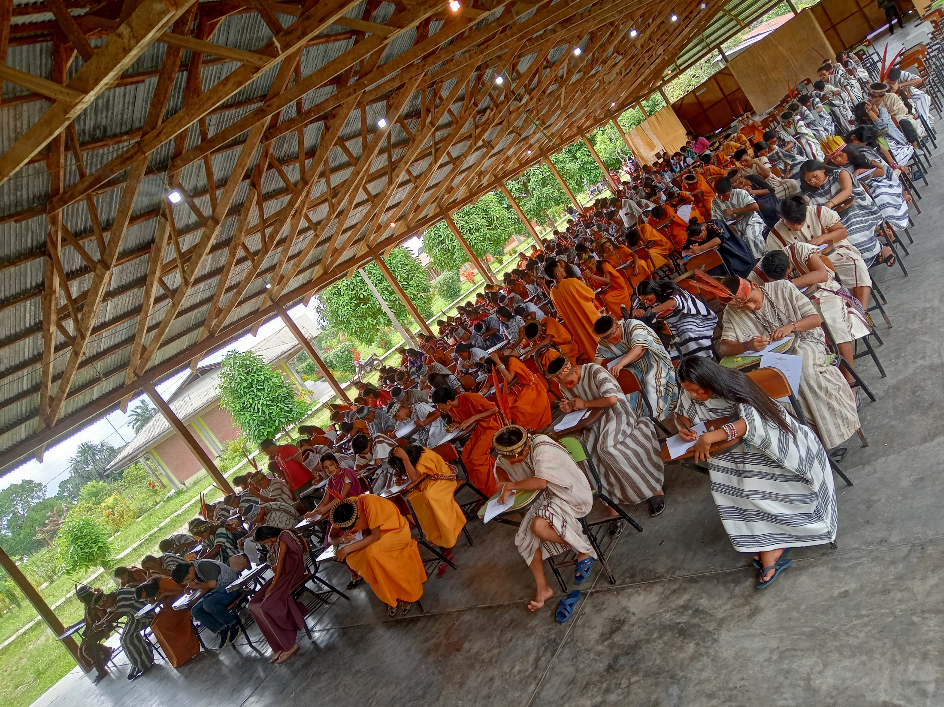
2017
THE SECRET OF NOPOKI
Nopoki is a unique example of very positive interaction between cultures, due to the fact that Amazonian original peoples send there not only their sons, but also some
of their “wise men" to work as professors in the Faculty
of Basic Intercultural Bilingual Education, teaching the students of their people their own language and culture.
In 2017 in Nopoki there were 7 original peoples, but their number increased due to the “endorsements” of Luz Salgado and Pope Francis

Slide 15
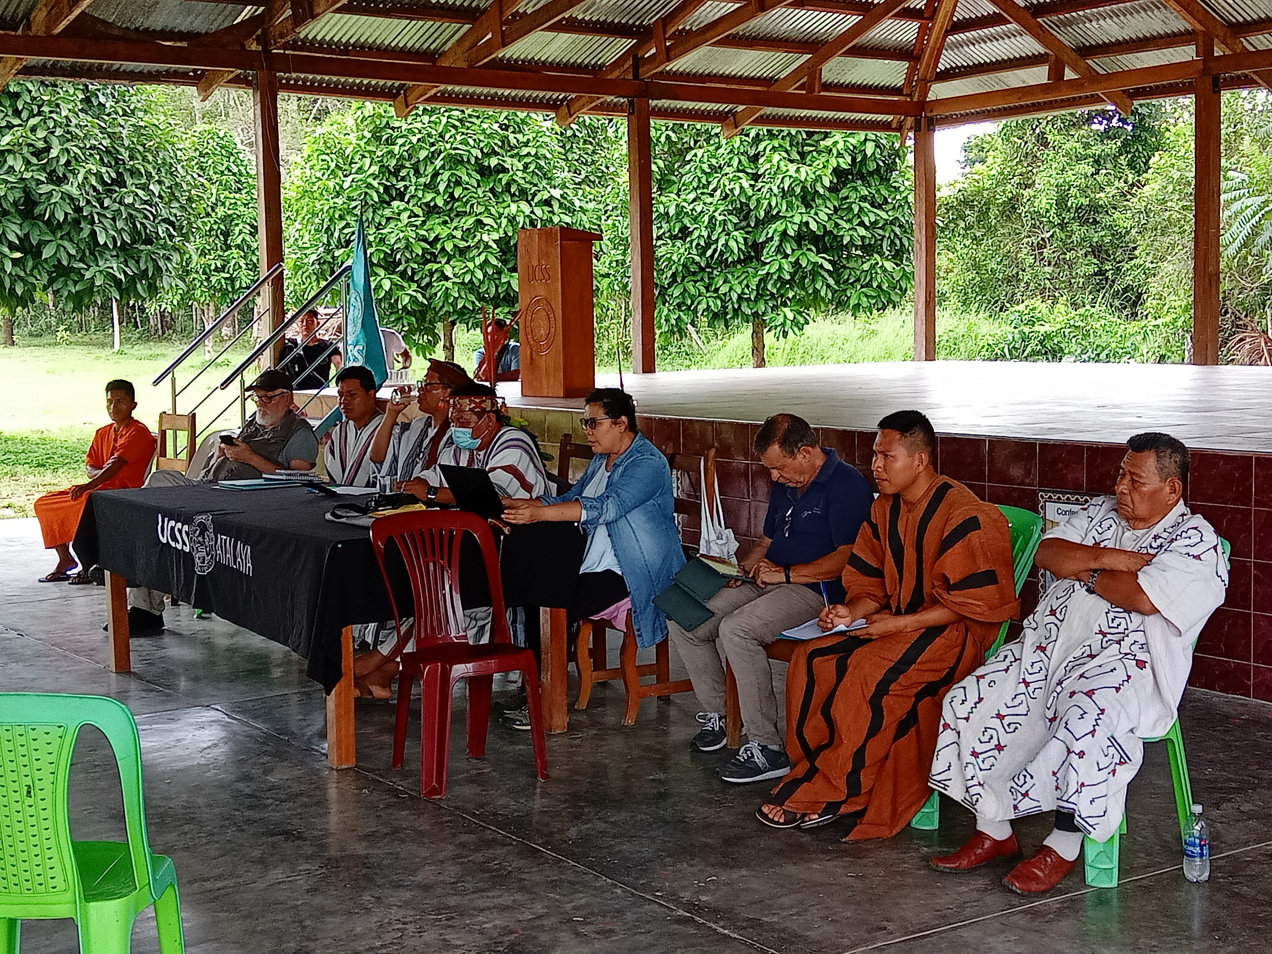
2019
NOPOKI AND SETI
Furthermore, they are now translating some textbooks
in Amazonian original languages, starting with grammar
and basic mathematics. So, we have the opportunity, unique in human history, of studying a real attempt
of translating Western culture in languages different both
from the Western ones and from each other, which very
often do not even have analogous concepts, to see if it influences their understanding. This is very interesting for anthropology, philosophy and – of course - also for SETI.
Today in Nopoki there are as many as 19 original peoples,
although not everyone still has its “wise” who teaches down there

Slide 16
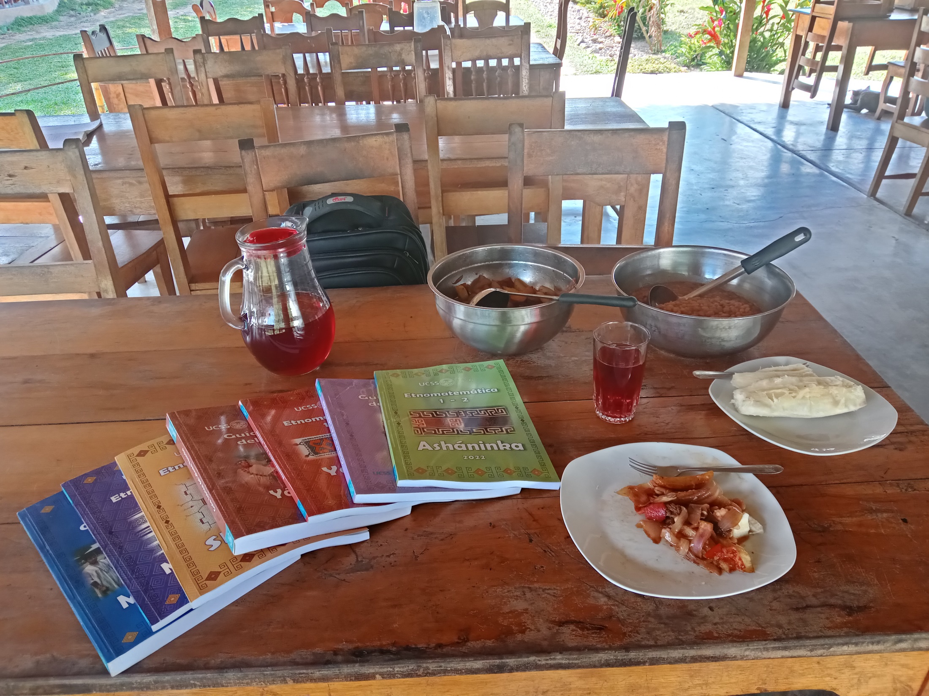
THE BOOKS OF NOPOKI
1) Statistical study on the learning of mathematics in Nopoki (November 2023).
2) Workshops on Interstellar Message Composition (December 2023).
3) Seminar on ethnomathematics at the EHESS (November 2024).

Slide 17
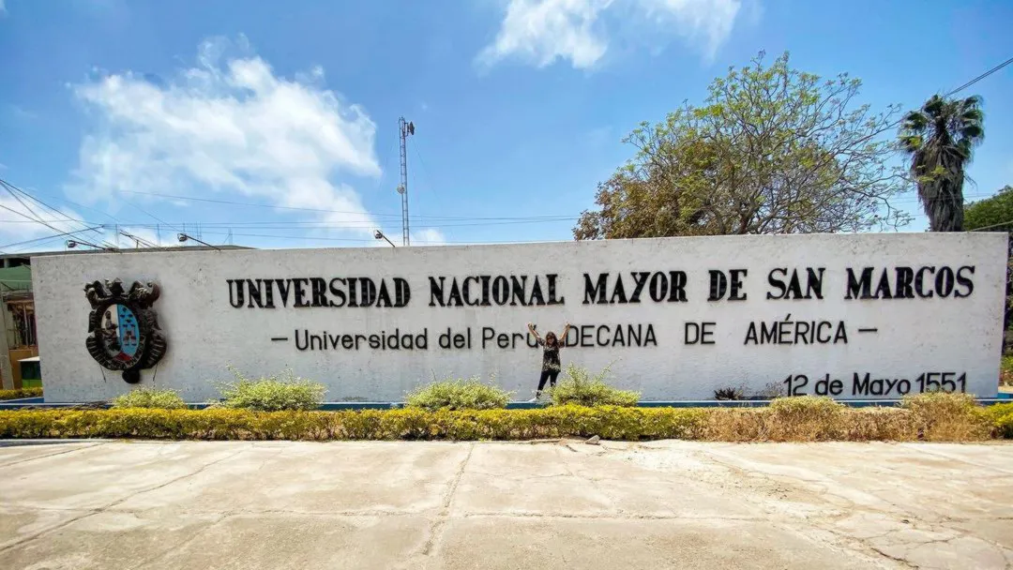
Seminar about interculturality in Nopoki at San Marcos

Slide 18
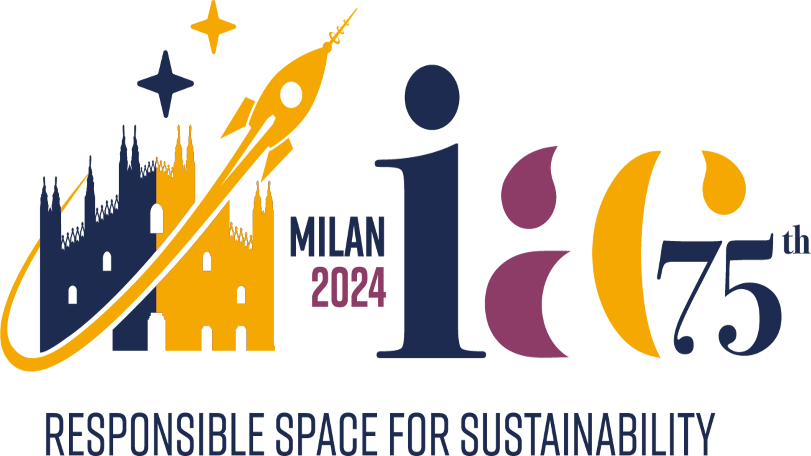
IAC 2024 AND RELATED EVENTS
The search for other civilizations
(16 October 2024)
2) The future of communication
(18 October 2024)
3) Back to the Moon
(19 October 2024)

Slide 19
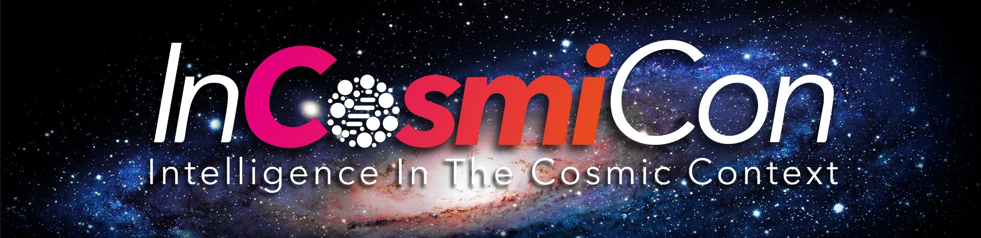

Do you want
to get on board ?
Then write
soon to …

Slide 20
www.incosmicon.net

